Slide 1
Chapter 1 Basic Concepts
1.1 Introduction
1.2 Systems of Units
1.3 Charge and Current
1.4 Voltage
1.5 Power and Energy
1.6 Circuit Elements
1.7 Summary

Slide 2
Chapter objectives
1.1 Introduction
Understand electric circuit and electric circuit model
Understand the basic SI units and SI prefixes
Learn about the concepts of charge, current and voltage
Learn about power and energy
Become familiar with the passive sign convention
Learn about the circuit elements including dependent and independent sources

Slide 3
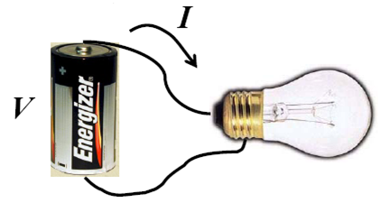
Introduction
What is engineering?
Purposeful use of science
What is an electric circuit about?
An electric circuit is an interconnection of electrical elements.
A simple electric circuit

Slide 4
What is the research object of this course?
Real electric circuits
Electric circuit models
What is an electric circuit model about?
An interconnection of ideal electrical elements.
×
√

Slide 5
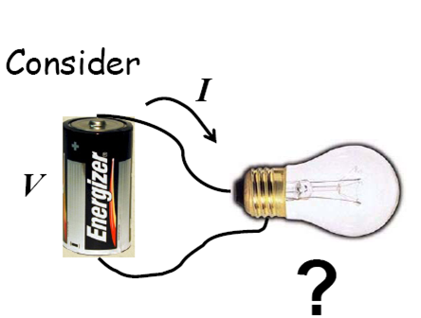
What is the current through the bulb?

Slide 6
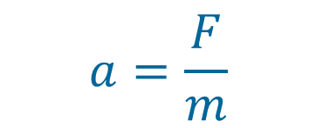
First, let us build some insight:
Analogy
F
a ?
I ask you: What is the acceleration?
You quickly ask me: What is the mass?
I tell you:
m
You respond:
Done!!!

Slide 7
First, let us build some insight:
Analogy
F
a ?
In doing so, you ignored
the object’s shape
its temperature
its color
point of force application
Point-mass discretization

Slide 8
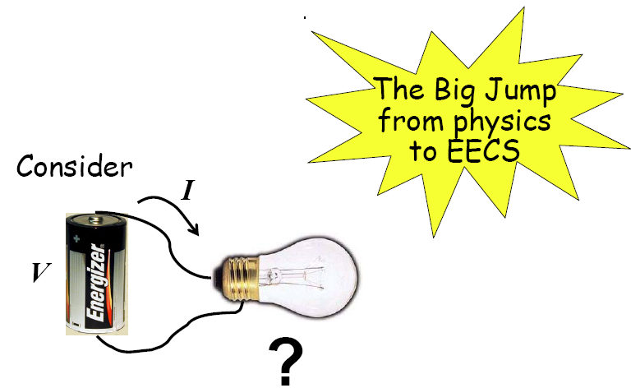
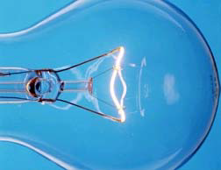
Consider the filament of the light bulb.
A
B
We do not care about
how current flows inside the filament
its temperature, shape, orientation, etc.
Then, we can replace the bulb with a
discrete resistor
for the purpose of calculating the current.

Slide 9
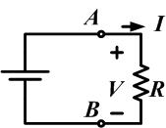


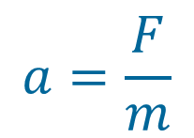
A
B
replace the bulb with a discrete resistor
for the purpose of calculating the current.
In EE, we do things the easy way …
and

Slide 10
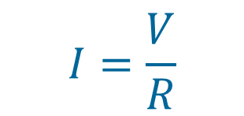
R represents the only property of interest!
R relates element v and i
called element v-i relationship
R is a lumped element abstraction for the bulb.
A lumped element can be idealized to the point where it can be treated as a black box accessible through a few terminals.

Slide 11
Lumped element
Lumped circuit model
i₁
i₂
Lumped-matter discipline
(LMD)
+
V
-
i₁=i₂ ;
V is certain
Linear----Nonlinear
Time invariant----Time variant
Passive----Active
Lumped----Distributive
Circuit Type:

Slide 12
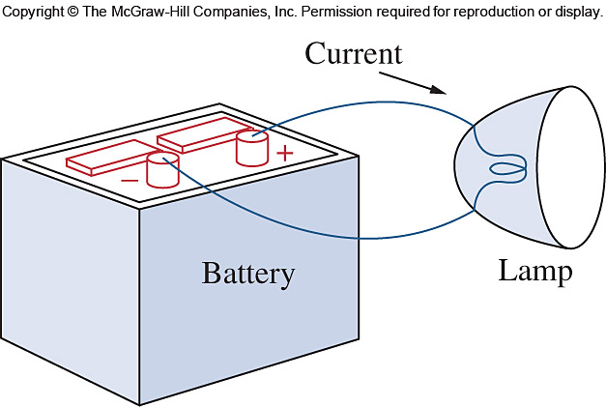
Electric circuit and electric circuit model
Actual electrical component: a battery or a light bulb
Ideal circuit component: a mathematical model of an actual electric component.
Circuit Model
Actual electrical component
Emphasize the main character
Ideal circuit component
Neglect the minor character

Slide 13
1.2 Systems of Units
SI (International System of Units)
An international measurement language
Adopted by the General Conference on Weights and Measures in 1960
The six basic SI units
Quantity Basic unit Symbol
Length meter m
Mass kilogram kg
Time second s
Electric current ampere A
Thermodynamic temperature kelvin K
Luminous intensity candela cd

Slide 14
SI System uses prefixes based on the power of 10 to relate larger and smaller units to the base unit. Each prefix represents a particular power of 10. Example: 2500 W is equivalent to 2.5 kW or 2.5 x 10⁻³ MW
The SI prefixes
Multiplier | Prefix | Symbol | Multiplier | Prefix | Symbol | Multiplier | Prefix | Symbol
10¹⁸ | exa | E | 10⁶ | mega | M | 10⁻⁹ | nano | n
10¹⁵ | peta | P | 10³ | kilo | k | 10⁻¹² | pico | p
10¹² | tera | T | 10⁻³ | milli | m | 10⁻¹⁵ | femto | f
10⁹ | giga | G | 10⁻⁶ | micro | μ | 10⁻¹⁸ | atto | a

Slide 15


1.3 Charge and Current
n Charge is an electrical property of the atomic particles of which matter consists, measured in coulombs (C).
Two types of charge
positive: (proton)
negative: (electron, -1.602 × 10⁻¹⁹ C )
Continuously transferring charge
total amount of charge never changed
neither created nor destroyed
(the law of conservation of charge)

Slide 16
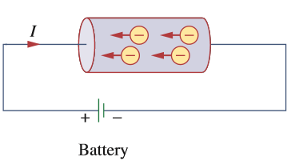
n Electric current is the time rate of change of charge, measured in amperes (A).
coulombs, C
seconds, s
A direct current (DC) is a current that remains constant with time. (I)
Sort
An alternating current (AC) is a current that varies sinusoidally with time. (i)

Slide 18
Reference direction
i >0 means the real direction is same to the reference direction
i <0 means the real direction is opposite to the reference direction

Slide 19
-------------------------------------------------
Practice 1.1:
In the wire of Fig. 1.4, electrons moving from left to right create a current of 1 mA. Determine I₁ and I₂.
----------------------------------------------------------------
Ans: I1 = -1 mA; I2 = +1 mA.

Slide 20
1.4 Voltage
Voltage (or potential difference) is the energy required to move a unit charge through an element, measured in volts(V).
joules, J
coulombs, C
Reference direction or voltage polarity
V>0 means the real polarity is same to the reference polarity
V<0 means the real polarity is opposite to the reference polarity

Slide 21
Electric voltage, v_{ab,} is always across the circuit element or between two points in a circuit.
v_{ab} > 0 means the potential of a is higher than potential of b.
v_{ab} < 0 means the potential of a is lower than potential of b.
We should note that a voltage can exist between a pair of electrical terminals whether a current is flowing or not.

Slide 24
Practice 1.2
For the element in Fig. 1.7, v1 =17 V. Determine v2.
---------------------------------------------------
Ans: v2 = - 17 V
----------------------------------------------------------------------

Slide 25
Notice
V: dc voltage (produced by a battery)
v: ac voltage (produced by an electric generator)
Keep in mind:
Current and voltage are the two basic variables in electric circuits
Electric current is always through an element
Electric voltage is always across the element or between two points

Slide 26
The polarity of voltage is indicated by a plus-minus pair of algebraic signs.
The definition of any voltage must include plus-minus sign pair!
Using a quantity v without specifying the location of plus-minus sign pair is using an undefined term.

Slide 28
passive sign convention
Passive sign convention is satisfied when current enters through the positive polarity of the voltage.
Unless otherwise stated, we will follow the passive sign convention throughout this course.

Slide 29
1.5 Power and Energy
Power is the time rate of expending or absorbing energy. Measured in watts(W)
joules, J
seconds, s
P=VI in a DC circuit
passive sign convention
Passive sign convention is satisfied when current enters through the positive polarity of the voltage.

Slide 30
Reference polarities for power using passive sign convention
Passive sign convention is satisfied when the current enters through the positive terminal of an element and p=+vi. If the current enters through the negative terminal, p=-vi.
Unless otherwise stated, we will follow the passive sign convention throughout this course.
p > 0 absorbing power
p < 0 supplying power

Slide 31
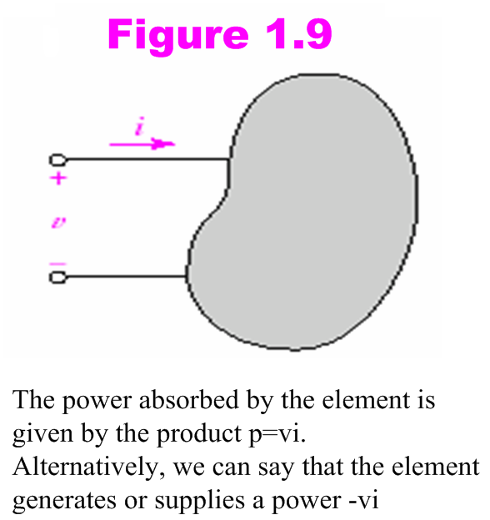

Slide 32
Law of conservation of energy must be obeyed in any electric circuit.
+ Power absorbed = - Power supplied
The algebraic sum of power in a circuit, at any instant of time, must be zero.

Slide 33
Example 1
Compute the power absorbed by each part in Fig. 1.10

Slide 34
Solution
In Figure 1.10a, with +3 A flowing into the positive reference terminal, we compute
P = (2 V) (3 A) = 6 W
of the power absorbed by the element.
Fig. 1.10b shows a slightly different picture. Now we have a current of -3 A flowing into the positive reference terminal. However, the voltage as defined is negative. This gives us an absorbed power
P = (-2 V) (-3 A) = 6 W

Slide 35
Reference to Fig. 1.10c, we again apply the passive sign convention rules and compute an absorbed power
P = (4 V) (-5 A) = -20 W
Since we computed a negative absorbed power, this tells us that the element in Fig. 1.10c is actually supplying +20 W (i.e., it’s a source of energy).

Slide 36
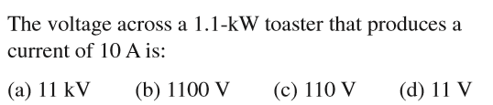
Practice
Answer : C

Slide 37
Practice 1.3
Find the power being absorbed by the circuit element in Fig. 1.11a.

Slide 38
Find the power being generated by the circuit element in Fig. 2.11b.
Find the power being delivered to the circuit element in Fig. 2.11c at t = 5 ms.
--------------------------------------------------------------
Answer : 1.012; -6.65w; -15.53

Slide 39
Energy is the capacity to do work, measured in joules(J)
The energy absorbed or supplied by an element from time t₀ to time t is
Notice:
The electric power utility companies measure energy in watt-hours (Wh)
1 Wh = 1W × 1(h) ×60(min/h) ×60(sec/min) =3,600 J
1 KWh = 1KW × 1(h)

Slide 40
Example 2
w=pt=100(W) ×2(h) ×60(min/h) ×60(sec/min)
=720,000 J
=720 KJ
w=pt=100(w) ×2(h)=200Wh=0.2 KWh
Practice
Answer: 50 s

Slide 41
1.6 Circuit Elements
An element is the basic building block of a circuit
Resistors
Passive elements
Inductors
Capacitors
Generators
Active elements
Batteries
The most important active elements:
Independent source
Voltage source
Current source
Dependent source

Slide 42
when we speak of Circuit Elements, It is important to differentiate between the physical device itself and the mathematical model which we will use to analyze its behavior in a circuit.
We will use the expression circuit element to refer to the mathematical model.
All the simple circuit elements that we will consider can be classified according to the relationship between the current through the element and the voltage across the element.

Slide 43
Voltage and Current Sources
The most important active elements are voltage or current sources that generally deliver power to the circuit connected to them. There are two kinds of sources: independent and dependent sources.
An ideal independent source is an active element that provides a specified voltage or current that is completely independent of other circuit elements.
Symbols for independent voltage source
Symbols for independent current source
(c)
(a)
(b)

Slide 44
An ideal dependent (or controlled) source is an active element in which the source quantity is controlled by another voltage or current.
Symbols for a) dependent voltage sources b) dependent current sources
There are a total of four variations, namely:
1. A voltage –controlled voltage source (VCVS)
2. A current –controlled voltage source (CCVS)
3. A voltage –controlled current source (VCCS)
4. A current –controlled current source (CCCS)
Notes:
A diamond is used to represent a dependent source. Both the dependent current source and the dependent voltage source may be controlled by either a voltage or a current elsewhere in the circuit.

Slide 46
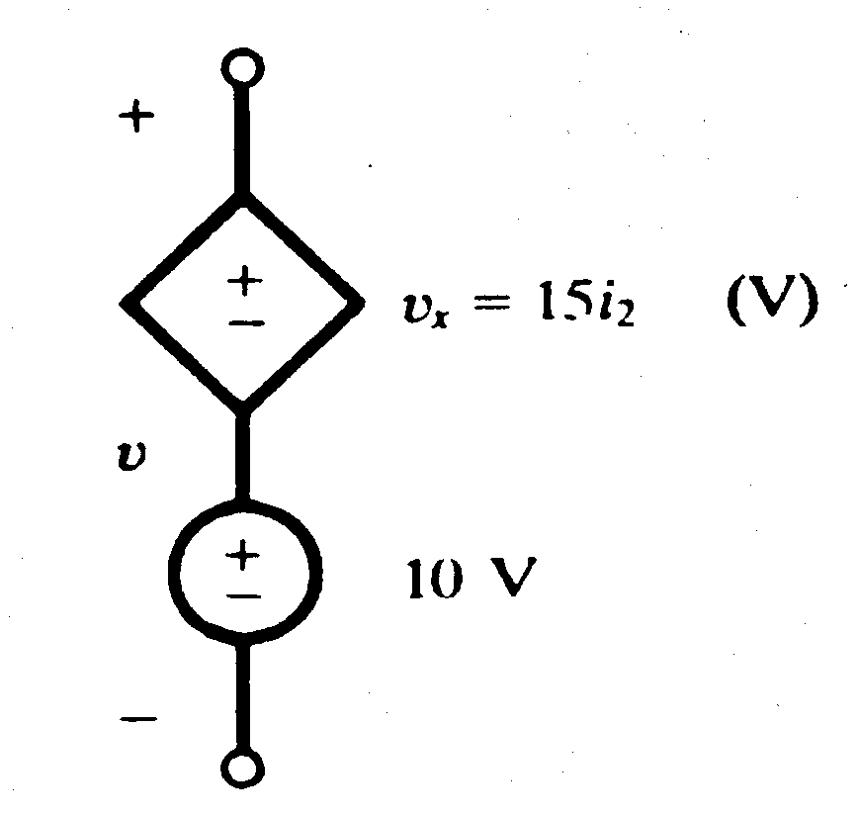
When dependent sources are given, their controlling current i_{x} and the controlling voltage v_{x} must be defined in the circuit.
Example 3
Obtain the voltage v in the branch shown in Figure 1.15 for i2 = 1A.
Figure 1.15

Slide 47
Solution
Voltage v is the sum of the current-independent 10-V source and the current-dependent voltage source v_{x}.
Note that the factor 15 multiplying the control current carries the units Ω.
Therefore, v = 10 + v_{x} = 10 + 15(1) = 25 V

Slide 48
---------------------------------------------------------------------------------------------------------------------------------------------------------------------------
Example 4
In the circuit of Fig. 1.16, if v₂ is known to be 3 V, find v_{L}.
+
+
v₂
v_{L}
5v₂
-
-
Figure 1.16

Slide 49
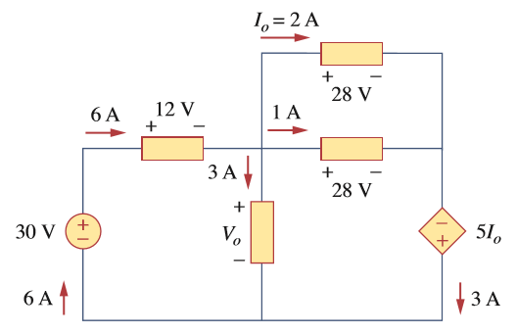
Example 5
Find Vo and the power absorbed by each element in the circuit.

Slide 50
Practice
----------------------------------------------------------------------------------------------------------------------------------------------------------------------------------------------------------------------------------------------------
1.4 Find the power absorbed by each element in the circuit in Fig. 1.17.
Figure 1.17
- -V_{x} +
5A
+
0.25v_{x}
+
+
-
12V
+
+
8V
8V
7A
20V
20V
-
2A
-
-
8A
-
-------------------------------------------------------------------------------------------------------------------------------------------------------------------------------------------------------------------------------------------------------------
Ans: (left to right) -56W; 16W; -60W;160W; -60W.

Slide 51
1.7 Summary
The system of units most commonly used in electrical engineering is the SI.
The direction in which positive charges are moving is the direction of positive current flow; alternatively, positive current flow is in the direction opposite that of moving electrons.
To define a current, both a value and direction must be given. Currents are typically denoted by the uppercase letter “I” for constant (dc) values, and either i (t) or simply i otherwise.

Slide 52
To define a voltage across an element, it is necessary to label the terminals with “+” and “-” signs as well as to provide a value (either an algebraic symbol or a numerical value).
Any element is said to supply positive power if positive current flows out of the positive voltage terminal. Any element absorbs positive power if positive current flows into the positive voltage terminal.
There are six sources: the independent voltage source, the independent current source, the CCCS, VCCS, and the CCVS,VCVS.

